Slide 1
Online Learning Application
Onteddu Sirisha Yadav
2/04/2019

Slide 2
The main objective of the E-Learning is to help the students get over the traditional methods of learning and make them accustomed to the internet . It provides an automation procedure of studying the concepts online. E-Learning is an inexpensive , efficient and comfortable way for students to easily access videos and an easier alternative to study for exams and learn new technologies.

Slide 3
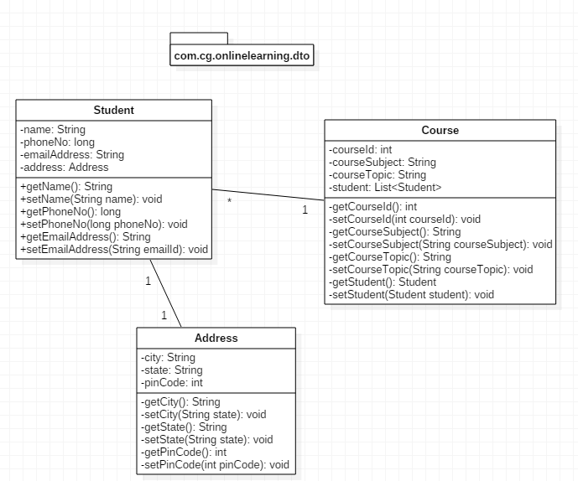
Pojo classes

Slide 4
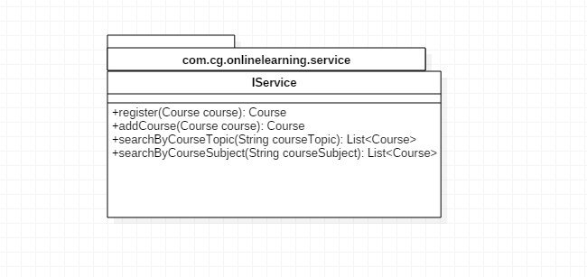
ServiceInterface

Slide 5
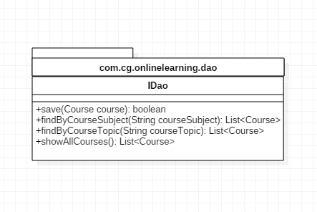
DaoInterface

Slide 6
Thank you…………!

